Slide 1
PROJECT PHASE 2
REVIEW 1
Department of CSE
Title : - Website Content Summarizer to Braille Conversion
Under guidance of
Prof Mrs.Sophia

Slide 2
TEAM MEMBERS
KARTHIK SHETTY K (1MJ22CS408)
NISAR AHAMED (1MJ22CS410)
RAJDURAI D KUDIYANNAVAR (1MJ22CS414)
WILLIAMS KA (1MJ22CS423)

Slide 3
ABSTRACT
The rapid expansion of digital content has made information widely accessible, but visually impaired individuals often face significant challenges in navigating and understanding online information. While screen readers provide basic accessibility, they lack efficiency in summarizing content and are not designed to cater to Braille users effectively. This project proposes a "Website Content Summarizer to Braille Conversion" system that bridges this gap by automating the summarization of website content and converting the extracted summary into Braille. The system leverages Natural Language Processing (NLP) techniques for summarization and Braille encoding algorithms for conversion. By delivering concise and relevant information in Braille, this solution aims to enhance accessibility and ensure inclusivity for visually impaired individuals. The proposed system focuses on user-friendly functionality, support for multiple languages, and adaptability to various content types, making it a valuable tool for enabling equal access to digital information.

Slide 4
INTRODUCTION
Access to information is a fundamental right, yet visually impaired individuals often face significant barriers when navigating the vast amounts of textual content available on websites. While screen readers help bridge the accessibility gap, they can be time-consuming and cumbersome, especially when dealing with lengthy or irrelevant information. For individuals who rely on Braille for reading, the challenge is even greater, as converting website content into Braille often requires expensive and specialized tools.To address these challenges, the proposed "Website Content Summarizer to Braille Conversion" system aims to create a streamlined and efficient solution. This system will automatically extract the most relevant information from website content through summarization techniques and convert the resulting text into Braille. By combining summarization and Braille conversion, this tool will empower visually impaired users to access web content more effectively, enhancing their independence and inclusion in the digital age.

Slide 5
PROBLEM STATEMENT
Inefficiency of Screen Readers
Limited Accessibility of Braille Conversion Tools
Need for Automatic Summarization
Lack of Multi-Language Support
User-Friendliness and Seamless Integration

Slide 6
EXISTING SYSTEM
Screen Readers (e.g., NVDA, JAWS):
  Inefficient for summarizing lengthy content.
Standalone Braille Translators (e.g., Duxbury, Braille Blaster):
  Do not provide summarization of web content.
Braille Displays (e.g., Refreshable Braille Devices):
  Lack built-in summarization capabilities.
Web Summarization Tools (e.g., Resoomer, SummarizeBot):
  Do not integrate Braille conversion.
Accessibility Features in Browsers:
  No support for Braille output.

Slide 7
PROPOSED SYSTEM
Accessibility:
  Enhances the accessibility of web content for visually impaired users by combining Braille, audio, and translation features.
Efficiency:
  Saves time by summarizing lengthy content and presenting only the essential information..
Multilingual Support:
  Enables users from different linguistic backgrounds to access web content in their native language..
Integrated Output:
  Provides multiple output formats (text, Braille, and audio) for flexibility and ease of use.
Cost-Effective:
  Utilizes open-source libraries and readily available tools to eliminate the need for expensive hardware or software.

Slide 8
LITERATURE SURVEY
YEAR | PAPER TITLE | METHODOLOGY | ADVANTAGES | LIMITATIONS | FUTURE SCOPE
2024 | Integrating the OCR technology, Braille displays, and the IoT, this paper introduces a concept leading the way for a paradigm shift in the lives of people with visual impairments and deaf blindness in our quickly evolving contemporary world. This study enhances assistive technology by combining it with the IoT, intending to empower persons with visual impairments and deaf-blindness. | The methodology section is a thorough breakdown of the approaches and strategies used to create our IoT-connected OCR-Braille application, outlining significant processes from information gathering to Braille translation integration. Gives a thorough overview of the process in our OCR-Braille program and illustrates how different parts integrate to allow people with visual impairments and deaf-blind people to access information in real-time. | These metrics accuracy, recall, F1 score, and error rate offer a quantitative and insightful view into the models' capabilities. | In essence, even while our current research has a considerable impact on the accessibility and assistive technology fields, its reach is not exhaustive. The OCR-Braille has the potential to be improved upon and its reach increased in the future directions outlined, including sophisticated IoT connectivity. | Accessibility could be further improved by including audio assistance for the blind in the IoT networking framework. Another area for development is the Braille translation algorithm's refinement to account for linguistic peculiarities and subtleties in different languages. The application's global impact can be increased by ensuring compatibility with a wider array of Braille display devices and increasing language support to include more languages.
2024 | The education of visually impaired children remains a focal topic, and the implementation of Braille–Chinese translation can facilitate improved understanding and learning of Braille for these children. Braille–Chinese translation refers to the conversion of Braille text into Chinese characters. | we will introduce three implementation methods of low-resource Braille–Chinese translation based on pre-trained and jointly trained language models | improving the traditional Chinese–Braille translation approach, the paper also devises a novel implementation pattern for Braille phoneme recognition based on the phonemic characteristics of Chinese Braille and in conjunction with pre-trained language models. | To develop a universal model in the domain of Braille with limited data, we proposed a Braille joint training method. | NONE

Slide 9
LITERATURE SURVEY
YEAR | PAPER TITLE | METHODOLOGY | ADVANTAGES | LIMITATIONS | FUTURE SCOPE
2024 | English to Arabic Braille Neural Machine Translation Through Corpus Augmentation | For training the two NMT models (Baseline and Corpus Augmented) we performed some common steps. Text Preprocessing, Sub Wording | The trained models were evaluated on 2000 sentences where a set of 1000 sentences were taken from the training corpus and another set of 1000 sentences were taken afresh. | hopefully improve the quality of translations. | English to Arabic Braille Neural Machine Translation system. We developed two NMT models, the first was a baseline model that used only the hyperparameters and the other model, a corpus-augmented model, where the corpus was first syntactically processed and then was sent to the NMT for training using the same hyperparameters used in baseline training.
2024 | Enhanced braille recognition based on piezoresistive and piezoelectric dual-mode tactile sensors | real-time and effective intelligent recognition of braille by flexible skin tactile sensor is realized by using random decision forest algorithm. Yan et al. [10] designed a magnetic tactile sensor, which uses an LSTM algorithm model to recognize braille characters with an accuracy of 97%. Liu et al. | The piezoelectric layer is made of PVDF piezoelectric material with good dynamic response | The experiments of braille recognition under different speed and different direction was designed to realize braille recognition under different contact states | Finally, the tactile sensor was put on the human hand, and the trained model can be used to help the blind to recognize braille.

Slide 10
LITERATURE SURVEY
YEAR | PAPER TITLE | METHODOLOGY | ADVANTAGES | LIMITATIONS | FUTURE SCOPE
2023 | Artificial intelligence for visually impaired | With huge technological advances in computer vision and deep learning, artificial intelligence is being used in medical imaging [51], [52], [53], [54], [55]. This is getting more attention as a novel treatment modality. The addition of AI methods in treating visual impairment has made doctors more accurate and faster in clinical screening, diagnosis, and prediction. In diagnosing eyes, fundus images are easily accessible and contain rich biological information, which is suitable as input datasets for CNN, GAN, and transfer learning. | The special binding and paper quality make these Braille books stronger and more durable. Compared to ordinary print materials, Braille materials are few and far between. | Due to their low vision, visually impaired people cannot access information by reading a text as regular people do, which is a serious problem they must face in the learning process. | In the information age, people are spending multiples-time with their eyes than in the past decades. They increasingly depend on video display terminals such as computers and televisions for various activities [160], [161], [162].
2023 | A Deep Learning-Based Recognition Approach for the Conversion of Multilingual Braille Images | The development of OBR systems has been an active field of research for many years [4]. Existing OBR technologies that interpret the images of Braille into texts are expensive, non-portable, and outdated. These types of constraints apply to processes such as correcting Braille image for skewness in OBR [11,12] and preservation and reproduction of Braille documents for the blind [13]. | Shokat et al. [23] presented a comprehensive survey analysis of OBR methods. Hsu [4] proposed a CNN model for recognizing 37 English Braille symbols. The model achieved 98.73% accuracy on a dataset with 26,724 images. | Limitations remain for the current state-of-the-art deep learning models and methods, and they cannot convert the Braille images effectively into multilingual texts or voices. These methods are not efficient for converting extensive lengths of Braille due to the use of line-by-line conversion. | Currently, there is a lack of a Braille image dataset for foreign languages. In future work, we need to collect a large-scale dataset for more foreign languages and test our approach on this dataset.

Slide 11
LITERATURE SURVEY
YEAR | PAPER TITLE | METHODOLOGY | ADVANTAGES | LIMITATIONS | FUTURE SCOPE
2022 | Automate extraction of braille text to speech from an image | We utilize the Braille Character Database to prepare our model. This dataset contains pictures having a place with 26 unique classes. The absolute number of preparing pictures is 1560. To begin preparing measure we will utilize all pictures for preparing where every one of the pictures are of measurements 28 × 28 in BW Scale. | Adam Optimizer (Adaptive Moment Estimation) is a versatile learning rate strategy that ascertains singular learning rates for various boundaries. | In dealing with rotated character images where the Google and Microsoft OCR APIs only obtain 65% and 34% accuracy rates. | The model suggested in this research paper is a modified custom CNN model that uses deep learning technologies for the classification of various braille characters. The model then uses these relevant features found out by multiple epochs of training to classify and find braille characters in any new image it obtains.
2022 | Image processing-based braille document copying system as additional feature for ITS’s braille printer | Braille translation is done by contour search to obtain information on each black dot. For each contour obtained, a filter is performed to remove the remaining noise from the image processing result. Furthermore, the contour information is used to determine each coordinate of every braille dots. | The printing result is then compared with the source document. From 312 letters, it successfully duplicates 311 letters correctly and the accuracy is 99.68 %. | The source document is then photographed with a mobile application that has been made for translation. Translation results are then sent to the add-on device and it command the printer to print document based on received data | On this research can be concluded that from 25 testing data with variety of spaces between letters, translation accuracy reaches 99%. Whole system testing was also done with end-to-end use case to show that the system can duplicate/copy braille documents. So that, braille document can be duplicated with the product of this research with accuracy of 99%..

Slide 12
LITERATURE SURVEY
YEAR | PAPER TITLE | METHODOLOGY | ADVANTAGES | LIMITATIONS | FUTURE SCOPE
2020 | Braille: Into the Next Millennium | A collection of essays discussing the future of Braille in the context of technological advancements and changing educational practices. | Subjects performed at an accuracy of 99.8%. The responses were recorded and analyzed offline, and additionally coded by the experimenter. Due to voice key failure we excluded 5.1% trials. | We did not observe any evidence for semantic priming beyond a target–prime distance of ±1; this diverges from earlier results obtained by Roggeman et al. (2007). One major difference between our paradigm and the task used by Roggeman et al. (2007) is the symbolic priming notation. | One has to consider the fact that priming is notoriously dependent on stimulus timing, that stimulus timing was, by necessity, slow, and that the subjects processing of Braille digits, while symbolic, was much less practiced than their processing of Arabic digits.
2020 | Unified English Braille: A Guide | This guide provides an overview of Unified English Braille (UEB), detailing the changes and implications for Braille users and educators | Fast,responsive | Complex inmplementation | the processing of visual letters converted to sound showed bilateral hemispheric processing but neither sighted nor blind experienced participants demonstrated a lateralization bias. Thus, the bilateral processing of vOICe stimuli may be due to additional recruitment of the right hemisphere in processing acoustic stimuli

Slide 13
LITERATURE SURVEY
YEAR | PAPER TITLE | METHODOLOGY | ADVANTAGES | LIMITATIONS | FUTURE SCOPE
2020 | HaptiRead: Reading Braille as Mid-Air Haptic Information | This research validates the use of mid-air haptics for conveying Braille characters, enabling blind individuals to read Braille through haptic feedback without physical contact. | Subjects performed at an accuracy of 99.8%. The responses were recorded and analyzed offline, and additionally coded by the experimenter. Due to voice key failure we excluded 5.1% trials. | We did not observe any evidence for semantic priming beyond a target–prime distance of ±1; this diverges from earlier results obtained by Roggeman et al. (2007). One major difference between our paradigm and the task used by Roggeman et al. (2007) is the symbolic priming notation. | One has to consider the fact that priming is notoriously dependent on stimulus timing, that stimulus timing was, by necessity, slow, and that the subjects processing of Braille digits, while symbolic, was much less practiced than their processing of Arabic digits.
2020 | Optical Braille Recognition Using Object Detection CNN | The paper introduces an optical Braille recognition method utilizing a convolutional neural network to detect entire Braille characters, enhancing the accuracy of Braille text recognition from images. | Fast,responsive | Complex inmplementation | the processing of visual letters converted to sound showed bilateral hemispheric processing but neither sighted nor blind experienced participants demonstrated a lateralization bias. Thus, the bilateral processing of vOICe stimuli may be due to additional recruitment of the right hemisphere in processing acoustic stimuli

Slide 14
METHODOLOGY
Problem Identification and Data Collection : Extract website content using web scraping tools like BeautifulSoup to fetch relevant text for processing.
Text Summarization : Apply Natural Language Processing (NLP) techniques using NLTK to summarize the extracted content effectively.
Translation and Braille Conversion : Use the Google Translator API for multilingual translation, followed by mapping text to Braille using custom dictionaries.
Audio Conversion : Generate audio output for the summarized text using Google Text-to-Speech (gTTS) for accessibility.
Frontend Integration : Develop a user-friendly interface with Flask, allowing users to input a URL, select a language, and view/download the summarized Braille or audio output.

Slide 15
ADVANTAGES & DISADVANTAGES
Advantages
Improved Accessibility
Time Efficiency
Braille Support
Multi-Language Support
Enhanced User Experience
Disadvantages
Complex Implementation
Dependence on Internet Connectivity
Accuracy Summarization

Slide 16
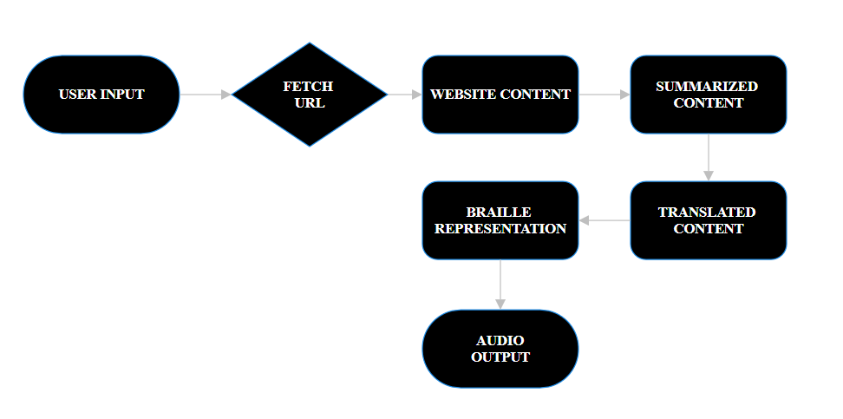
SYSTEM DESIGN
Fig – Website Content Summarizer to Braille Conversion

Slide 17
IMPLEMENTATION
BACK END
Flask Framework
  Core web framework for handling HTTP requests and serving the application
  Provides routing, request handling, and response generation
Web Scraping and Content Extraction
  Likely using libraries like BeautifulSoup or Newspaper3k to extract content from websites
  Extracts title, main content, and relevant text from URLs
Text Summarization
  Natural Language Processing (NLP) techniques to generate concise summaries
  Possibly using libraries like NLTK, spaCy, or transformers-based models

Slide 18
IMPLEMENTATION
BACK END
Translation Services
  LibreTranslate API integration for translating content between languages
  Supports multiple languages including English, Hindi, and Kannada
Braille Conversion
  Custom implementation for converting text to Braille patterns
  Specialized handling for different language scripts
Text-to-Speech
  Audio generation for the summary content
  Likely using a TTS library or service to create MP3 audio

Slide 19
IMPLEMENTATION
FRONT END
Modern UI Framework
  Bootstrap 5 for responsive layout and components
  Custom CSS with variables for theming and consistent styling
Interactive Elements
  Form handling for URL submission
  Language selection dropdown
  Loading indicators and error handling
Document Generation
  Word document generation using HTML-to-DOC conversion
  Text file generation for plain text output

Slide 20
IMPLEMENTATION
FRONT END
Copy to Clipboard Functionality
  JavaScript implementation for copying Braille output
Audio Playback
  HTML5 audio player for TTS output
  Custom play button with visual feedback
Visual Design
  Dark tech-themed UI with gradient effects
  Card-based layout for content organization
  Responsive design for different screen sizes
  Animation effects for better user experience

Slide 21
APPLICATIONS
1. Accessibility Solutions
  Visual Impairment Support: Provides direct access to web content for blind and visually impaired individuals through Braille conversion
  Multilingual Accessibility: Extends accessibility to non-English speakers with Hindi and Kannada support
2. Education and Learning
  Educational Materials: Converts educational websites and resources into Braille for visually impaired students
  Library Resources: Enhances accessibility of digital libraries and academic repositories
3. Public Services
  Library Services: Enhances public library digital offerings for visually impaired patrons
  Community Centers: Provides tools for community centers serving people with disabilities

Slide 22
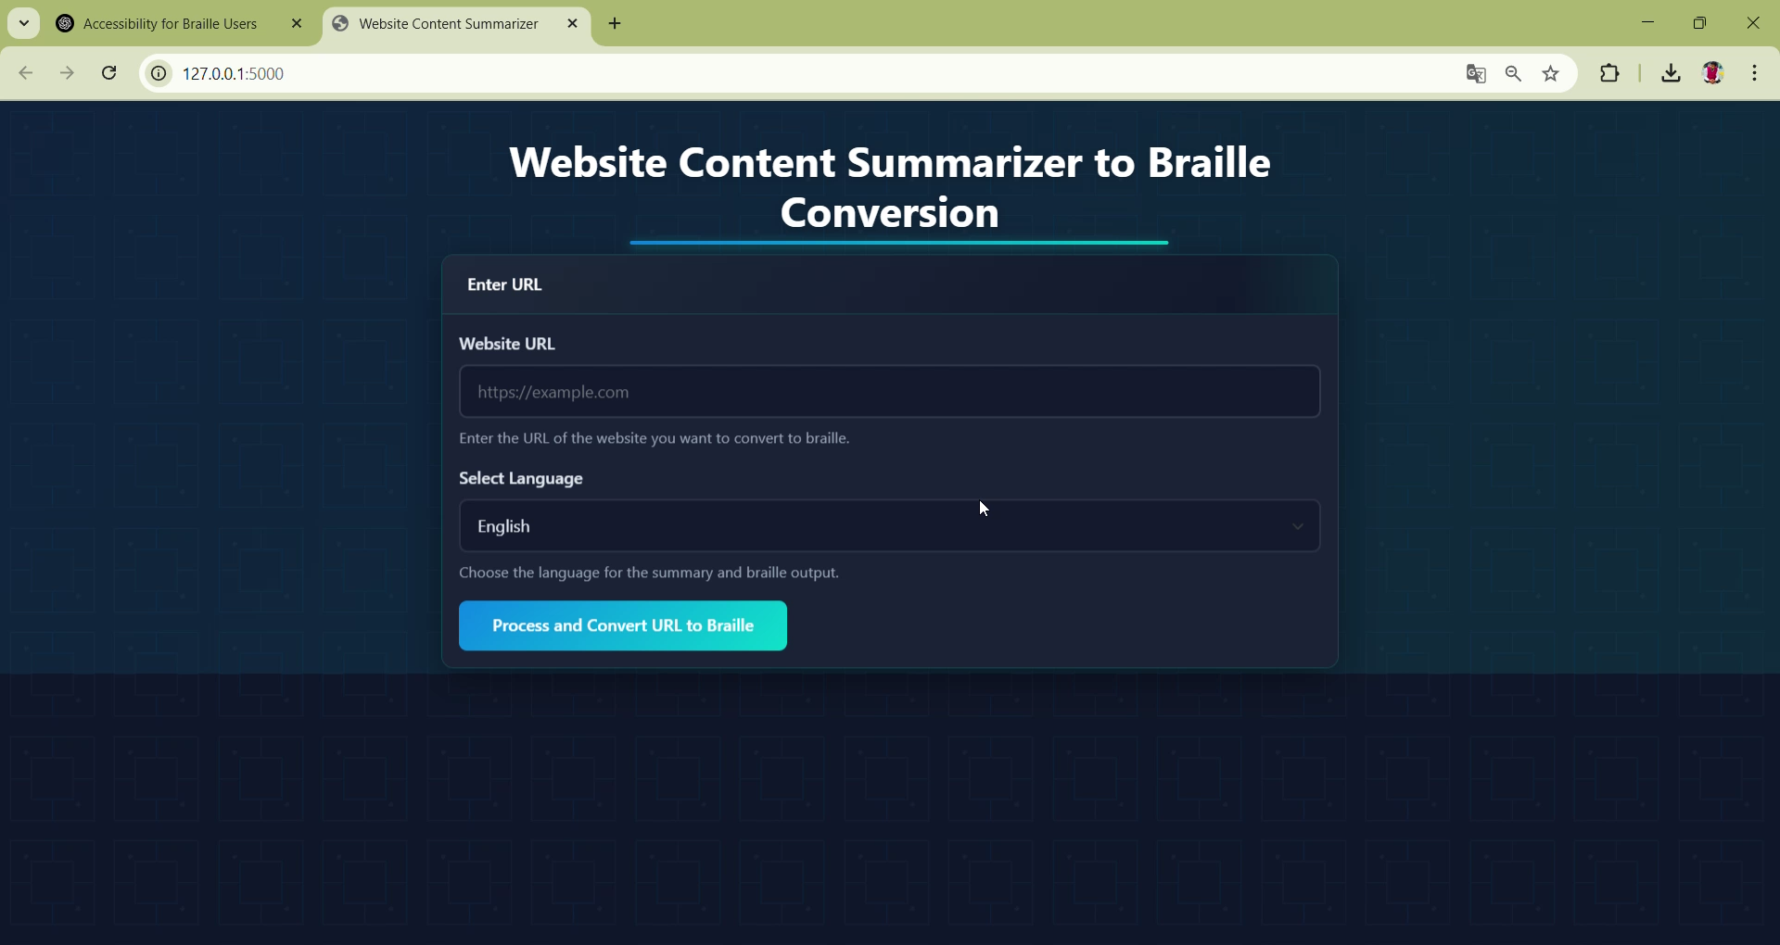
DEMONSTRATION

Slide 23
CONCLUSION
The Website Content Summarizer to Braille Conversion project is designed to address the growing need for accessible digital content for visually impaired individuals. By leveraging cutting-edge web scraping techniques, natural language processing (NLP) for content summarization, and Braille translation, the system will enable users to easily convert website content into readable Braille formats. This process will not only enhance accessibility but also provide a seamless user experience for individuals who rely on Braille for reading. The project focuses on ensuring that content is concise, accurate, and relevant, giving users a clear and comprehensible summary of web-based information. The system will provide both extractive and abstractive summarization methods, ensuring flexibility in summarizing content based on user preferences. By offering Braille in standard formats such as .BRF and .PEF, the solution ensures compatibility with common Braille devices and displays, while also providing the option for users to view Braille patterns directly on-screen.

Slide 24
THANK YOU!

